Slide 1
App Project 2024
Welcome to your summer at Hyland 😎🌞🌅🌴🌊

Slide 2
Agenda
Internship Homepage
Internship Overview
Team Processes
AUTOHACK IDLE
First Week Checklist

Slide 3
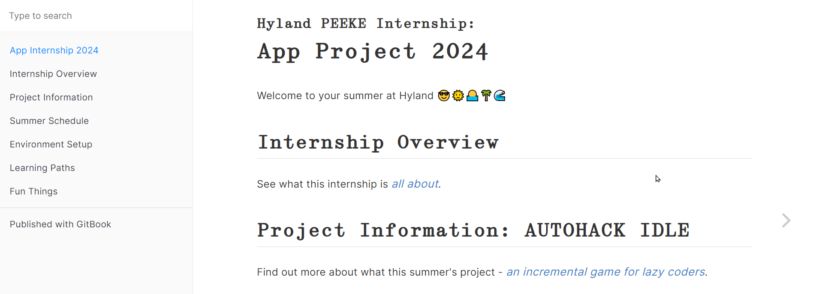
Internship Homepage
https://hylandtechoutreach.github.io/app-internship-2024

Slide 4
Internship Overview
Philosophy & Goals: it’s up to you
Project: AUTOHACK IDLE
Expectations: be professional
Dealing with downtime: fun things

Slide 5
Team Processes
agile-ish, trunk-based development-ish

Slide 6

Software Development Teams
Software Development Teams work together to build a software project.
Every team is different, and there are dozens of philosophies, methodologies, and paradigms, but for the purposes of this lesson…
Autonomous: Teams are self-governing and self-directing
Cross-functional: Members have different functional expertise
Notes:
To start things off, what is a software development team?
Put simply, software development teams work together to build a software project.
Now, every team is different… but at many software companies like Hyland, teams share some characteristics.
Teams are autonomous – which means they are self-governing and self-directing. Basically, they decide how best to work together and complete tasks.
Teams are also cross-functional – this means that team members have different specialties and have specific roles. So, what are some of those roles?

Slide 7

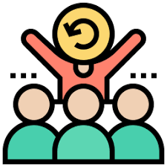





Software Development Roles
UI/UX Designer
Scrum Master
Quality Assurance
Stakeholder
Want the product; provide feedback
Design the product; look & feel & flow
Organize the team; help them function
Test the product; make sure it works
Software Architect
Product Owner
Software Developer
Plan the technical aspects of the product
Guide the product; decide on features
Make the product; write and review code
Notes:
As mentioned before, there are many ways to organize a software development team. That said, most teams will have at least some of these roles.
The most basic role isn’t actually someone on the team – it’s the stakeholder. This is typically a customer or end-user – someone who wants the product. Stakeholders provide feedback throughout the process to ensure that the team is actually building what they want. But how do they make their dream product into a reality?
The product owner is someone who guides the product itself. They listen to the stakeholder and figure out what’s most important in the product – they then help define and prioritize work for the team at the product level. Basically, they turn the dream of the stakeholder into a list of specific features.
The software architect takes that list of features and figures out how to implement them in the grand scheme of things. They are responsible for choosing the technologies, paradigms, and overall view of the product. Basically, they plan out the big picture of how to develop the nuts and bolts of the product.
The ui/ux designer is responsible for the actual user-facing design of the product. Does anyone know what UI or UX stand for? UI stands for User Interface, and UX stands for User Experience. They design how things will look and feel and flow – they always have the end users in mind and try to create the best possible experience for them.
After a whole lot of planning from all of those people, the software developer is responsible for actually making the product. They write the code, and review code from their fellow software developers.
Unfortunately, software developers are not always perfect; they need some quality assurance. These people are responsible for testing the product; they have to make sure it works and does exactly what it is supposed to do. Some testers do manual testing, where they act as if they are end-users; other testers write code that runs automated tests.
There is one more important role here: the scrum master. This person is responsible for organizing the team and doing anything they can to make sure the team functions as efficiently as possible. But does anyone know what scrum means? We’ll talk about that on the next slide 🙂

Slide 8
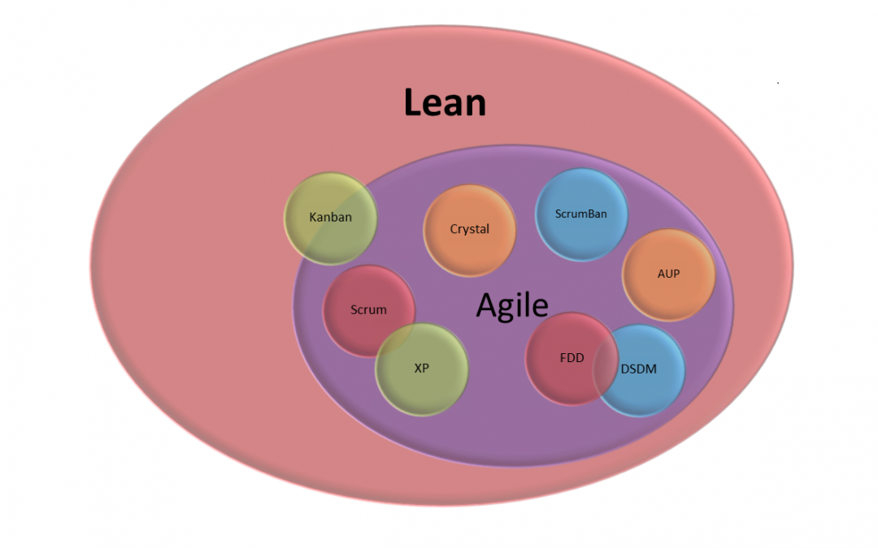
Development Methodologies
How does a team develop software?
so many overlapping paradigms, philosophies, and methodologies…
Agile, Scrum, Lean, DevOps, Waterfall, Kanban, more
Notes:
So, we have the team assembled, but how do they actually develop software?
Well, there are a ton of different ways to do it…
Lots of overlapping paradigms, philosophies, and methodologies… basically, lots of ways to plan out the projects and actually complete the work.
There are things like Agile, Scrum, Lean, DevOps, Waterfall, Kanban, and more… we won’t talk about all of these and what they mean, but they all relate to the process around which software is developed.

Slide 9



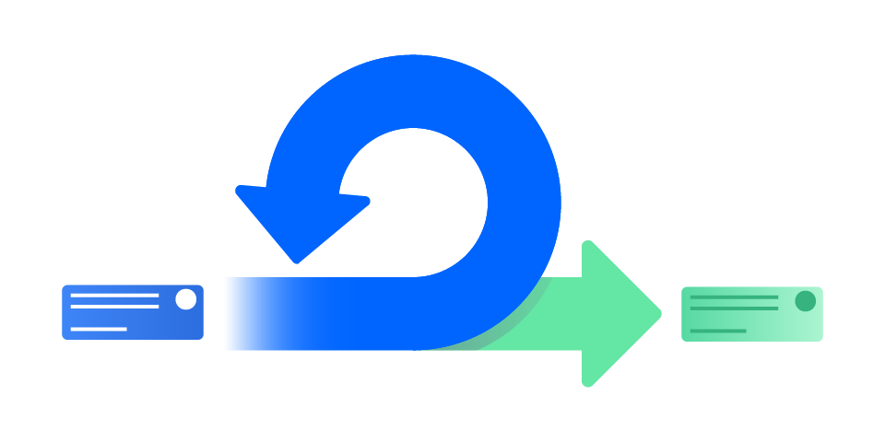


Agile/Scrum*
*ish
Stand-Up
Daily - discuss yesterday’s work, today’s work, any roadblocks
Sprint Demo
End of Sprint - review the completed work
Short, time-boxed period when a team completes a set amount of work
~2wks
Sprint Restrospective
After Sprint - talk about what went well, what went poorly, how to improve
Sprint Planning
Start of Sprint - decide what to do during the sprint period
Notes:
Let’s take a look at the basics of Scrum (ish), which is under the broader Agile philosophy.
In scrum, there are these things called sprints – they are short, time-boxed periods when a team completes a set amount of work. They are often two weeks long. You can basically think of these as two week chunks when people have some work they’re trying to accomplish.
These sprints kick off with a sprint planning meeting. This is where the team decides what to do in the next time block. They have a prioritized list of tasks, and figure out what they can accomplish in two weeks as a team.
Every day during the sprint, there is something called a stand-up; it’s a quick meeting where everyone on the team talks about what they did yesterday, what they are doing today, and any roadblocks they have. This helps everybody on the team stay on the same page with the pace and progress of the sprint.
At the end of the sprint, the team holds a sprint review. This is where they demonstrate the work they completed during the sprint. Stakeholders might be present for these demos; the team gets to show off all the great work they did!
After the sprint, teams will often hold a retrospective. The purpose of these is to figure out how to improve for the next sprint. They talk about what went well, what went poorly, and anything they want to start doing for next time. All of these scrum rituals can be very valuable to help the team achieve the best possible outcome for their project!

Slide 10

Iteration & Feedback
Get the right feedback at the right time
Break down the needs of the project into small, manageable increments
Each iteration should be focused on improving the product in specific, testable ways
Spend 10 minutes drawing up a mockup
Show it to a stakeholder
They hate it
Spend 10 hours working on a prototype app
Show it to a
stakeholder
They hate it
A
B
better→
FAIL FASTER
Notes:
Let’s talk a bit more about iteration, and the role of feedback.
The first step for iteration is to break down the needs of the project into small, manageable increments.
Then, each iteration should focus on improving the product in a specific, testable way. Keeping the iterations small makes it much easier to complete each individual part. But how should the team incorporate feedback?
It’s super important to get the right feedback at the right time. Imagine two scenarios:
In case A, you spend 10 minutes drawing up a mock-up of your application.
In case B, you spend 10 hours writing some actual code and building a prototype of your application.
In either case, you show what you’ve built to a stakeholder…
And, it turns out, they hate it. Now, which of these scenarios is better?
The better one is case A, because you didn’t waste 10 hours on something that isn’t ultimately useful!
The big lesson here is that it’s important to fail quickly. This way, you can adjust and make things better before getting too deep into something that’s going nowhere.

Slide 11
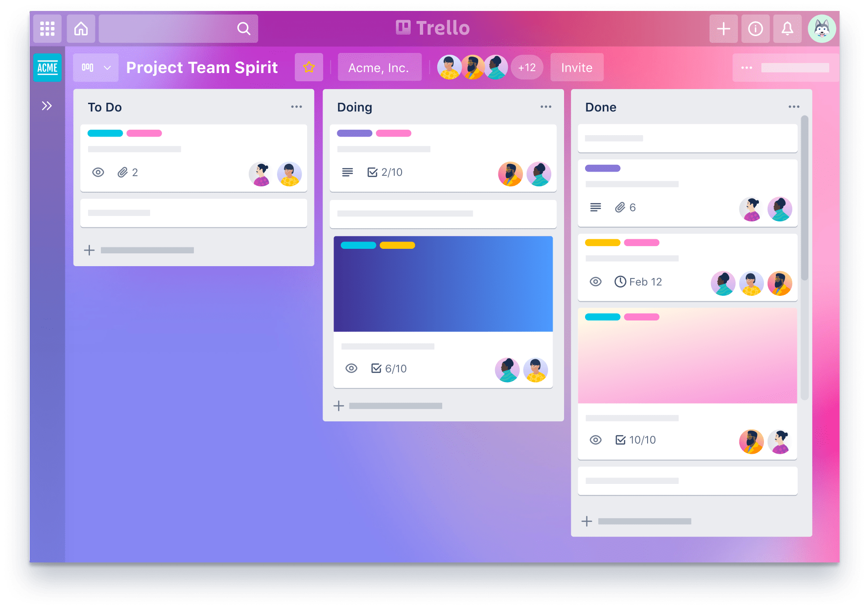
Tracking Work
Issues | Stories | Tickets | Cards
Units of work (2-4 hours)
Features or bug fixes
Status: Backlog, To Do, Doing, Review, Done
Kanban(看板)
Agile method
Cards pulled from one status to the next
Continuous improvement
GitHub has Kanban boards
Notes:
Now, after you’ve done a lot of planning and maybe some mock-ups, you’ll want to start working.
There are things called issues, or stories, or tickets, or cards – they are all synonymous.
Basically, these are just ways to represent units of work – optimally about 2 or 4 hours worth of work
These could be new features, or bug fixes
Each of these cards has a status; something like To Do, Doing, Review, or Done
These different lanes and statuses are part of a process called Kanban
This is a method that falls under the agile philosophy
It’s very simple; cards get pulled from one status into the next, and allow the team to track every piece of work at a glance
The goal of Kanban is to allow for continuous improvement of the process. It’s easy to see if there are bottlenecks or other issues.
There is an online tool called Trello that uses Kanban boards to track cards through custom statuses. Trello is a simple free tool, and it’s great for simple project management.

Slide 12
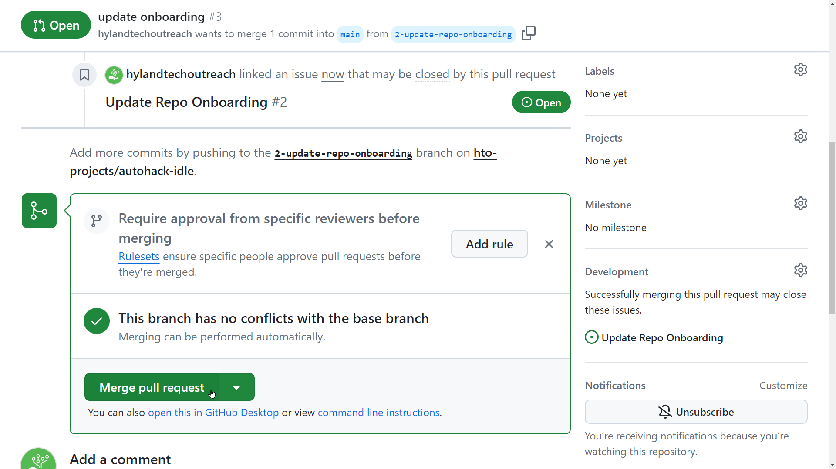
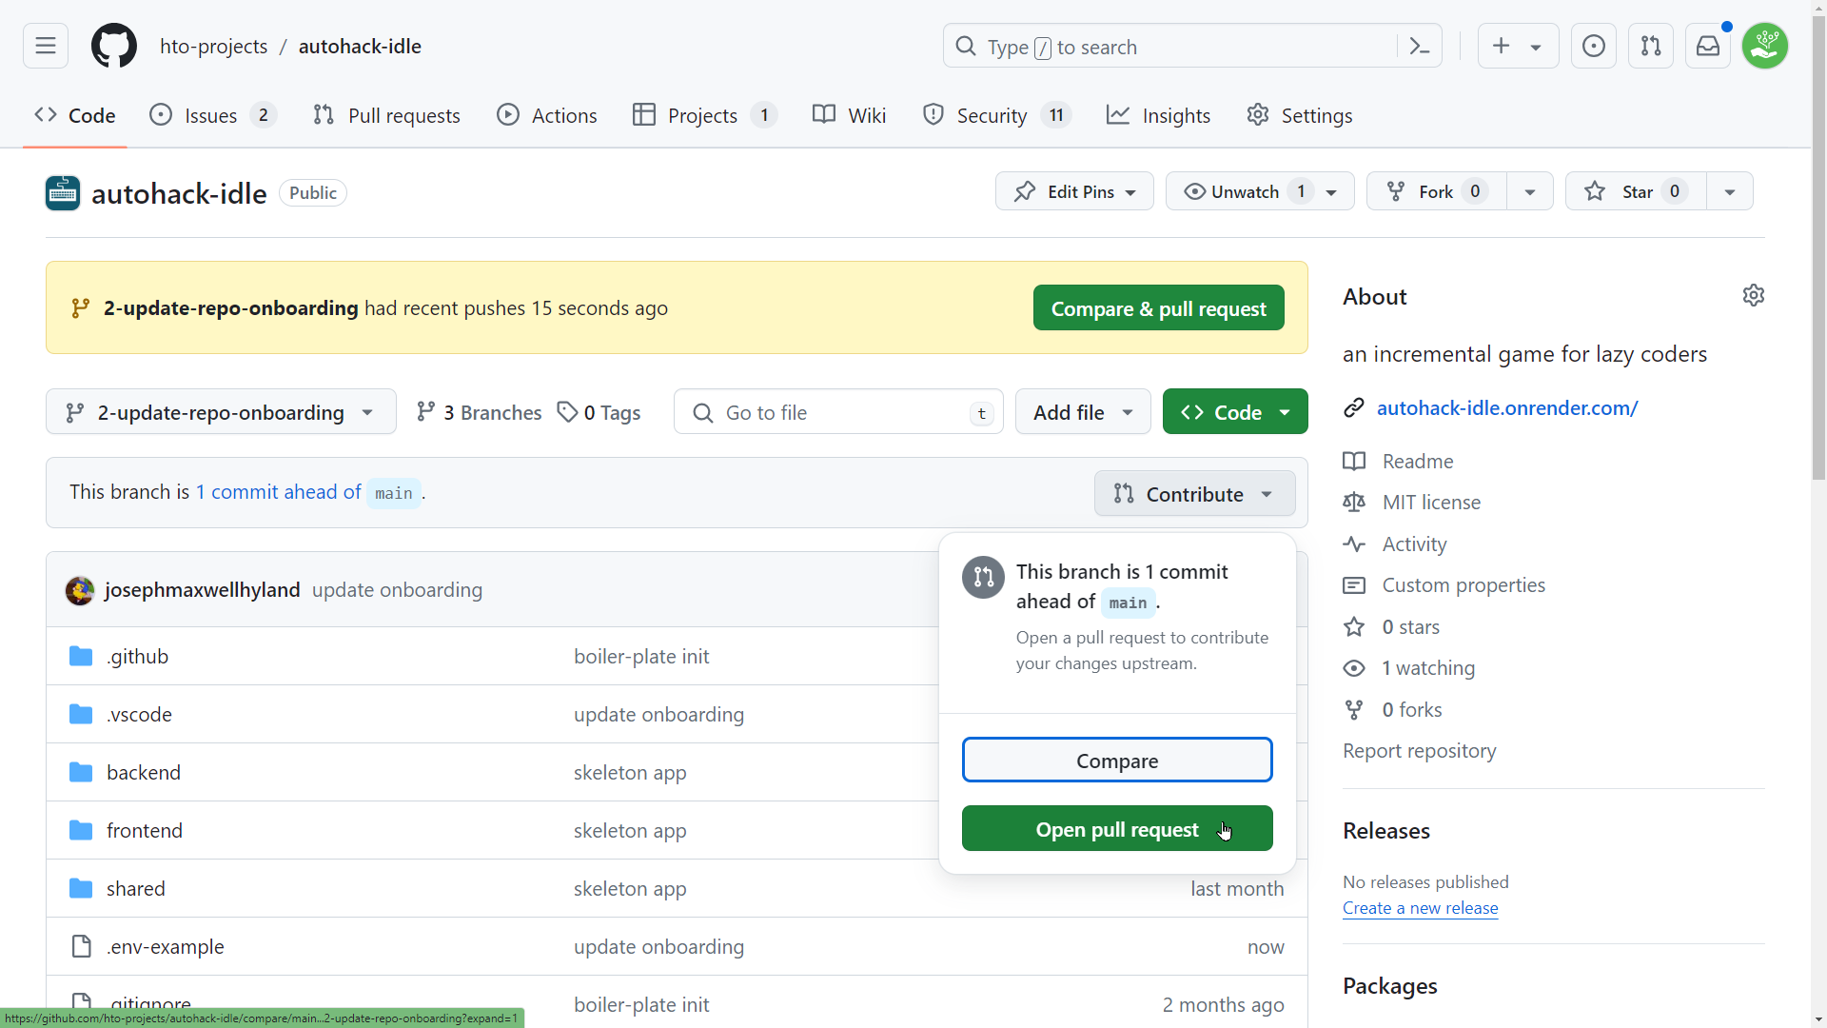
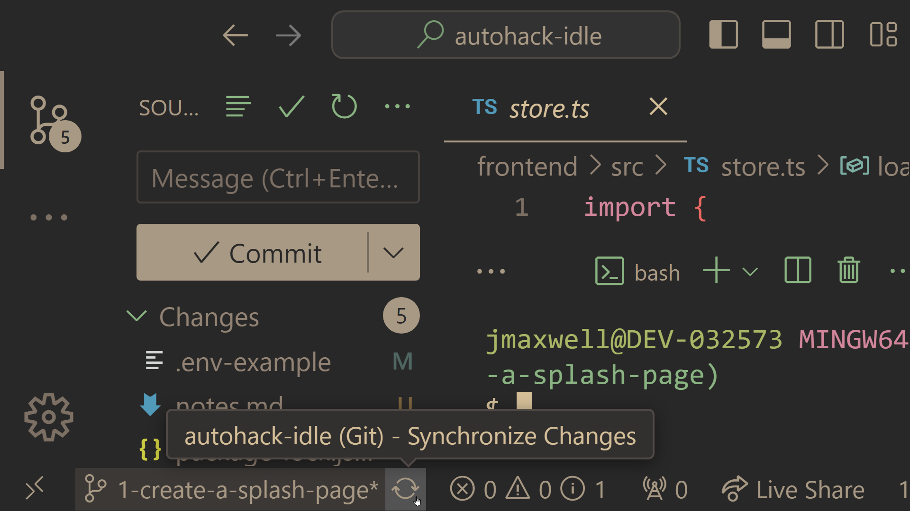
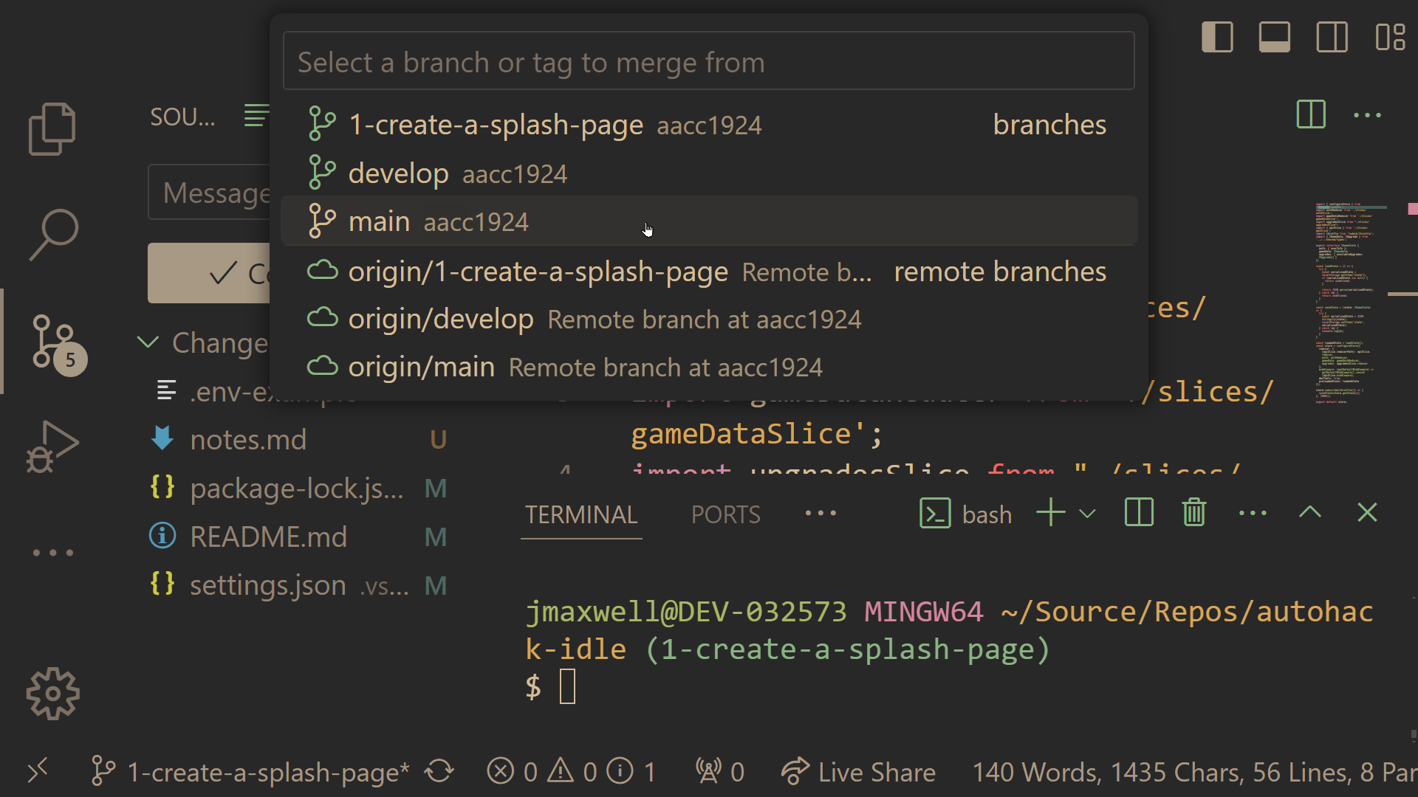
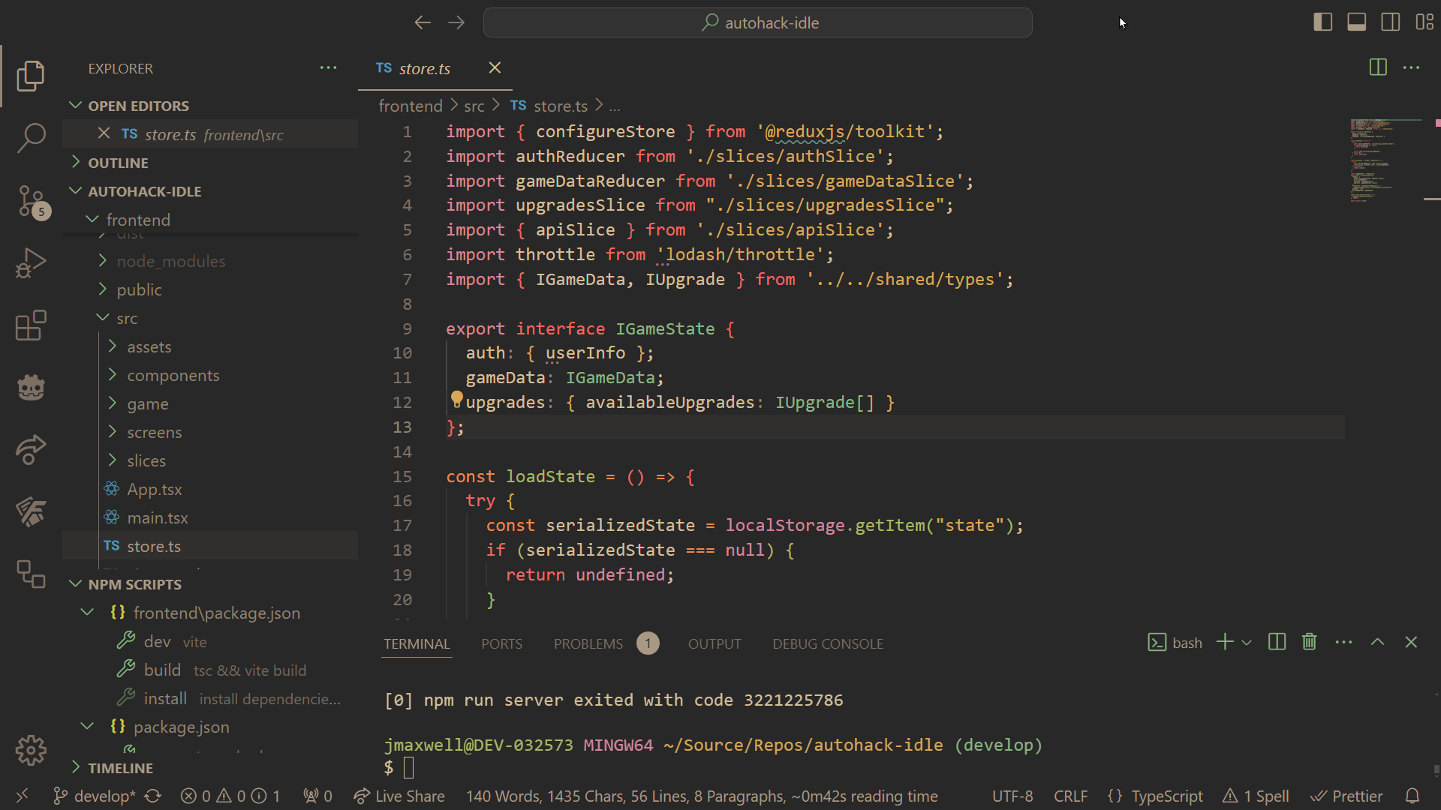
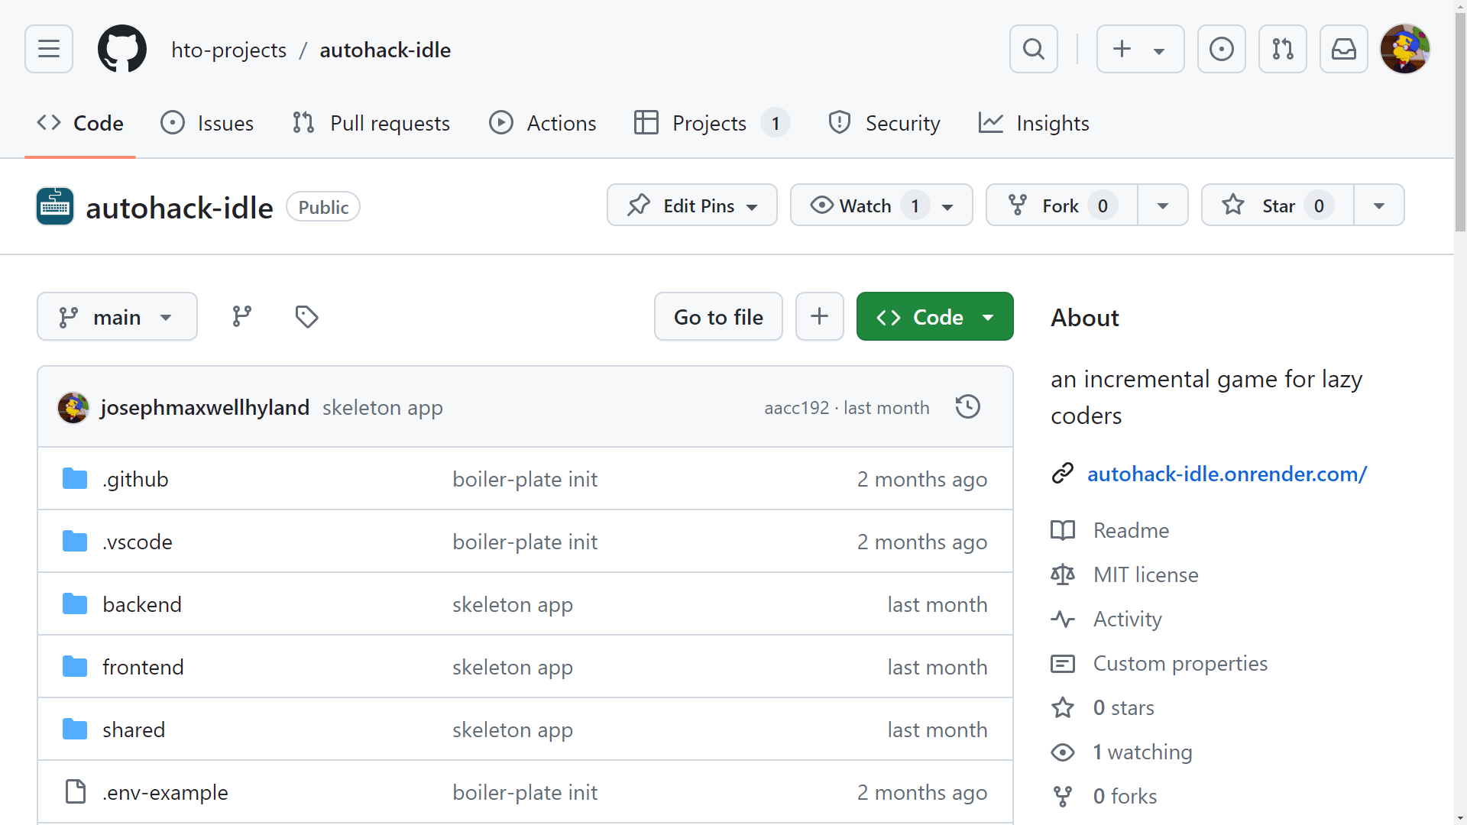
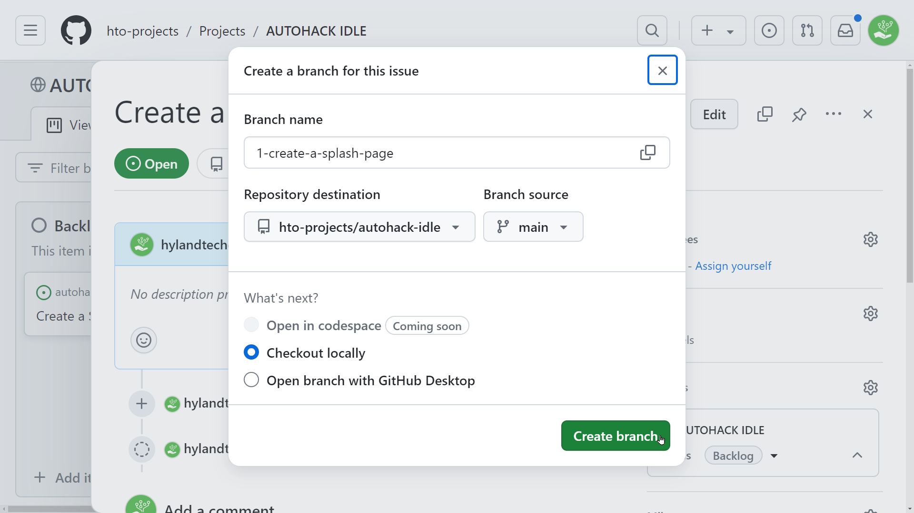
Trunk-based Development
Main codebase lives on the main branch
When you’re working on an issue, create a feature branch
Develop locally on the branch
Be sure to pull the latest from main and merge those changes into your feature branch
🐘
Push up to the remote feature branch
Create a pull request, and team members will review
Merge your feature branch into main, or…
Continue development until changes are ready

Slide 13
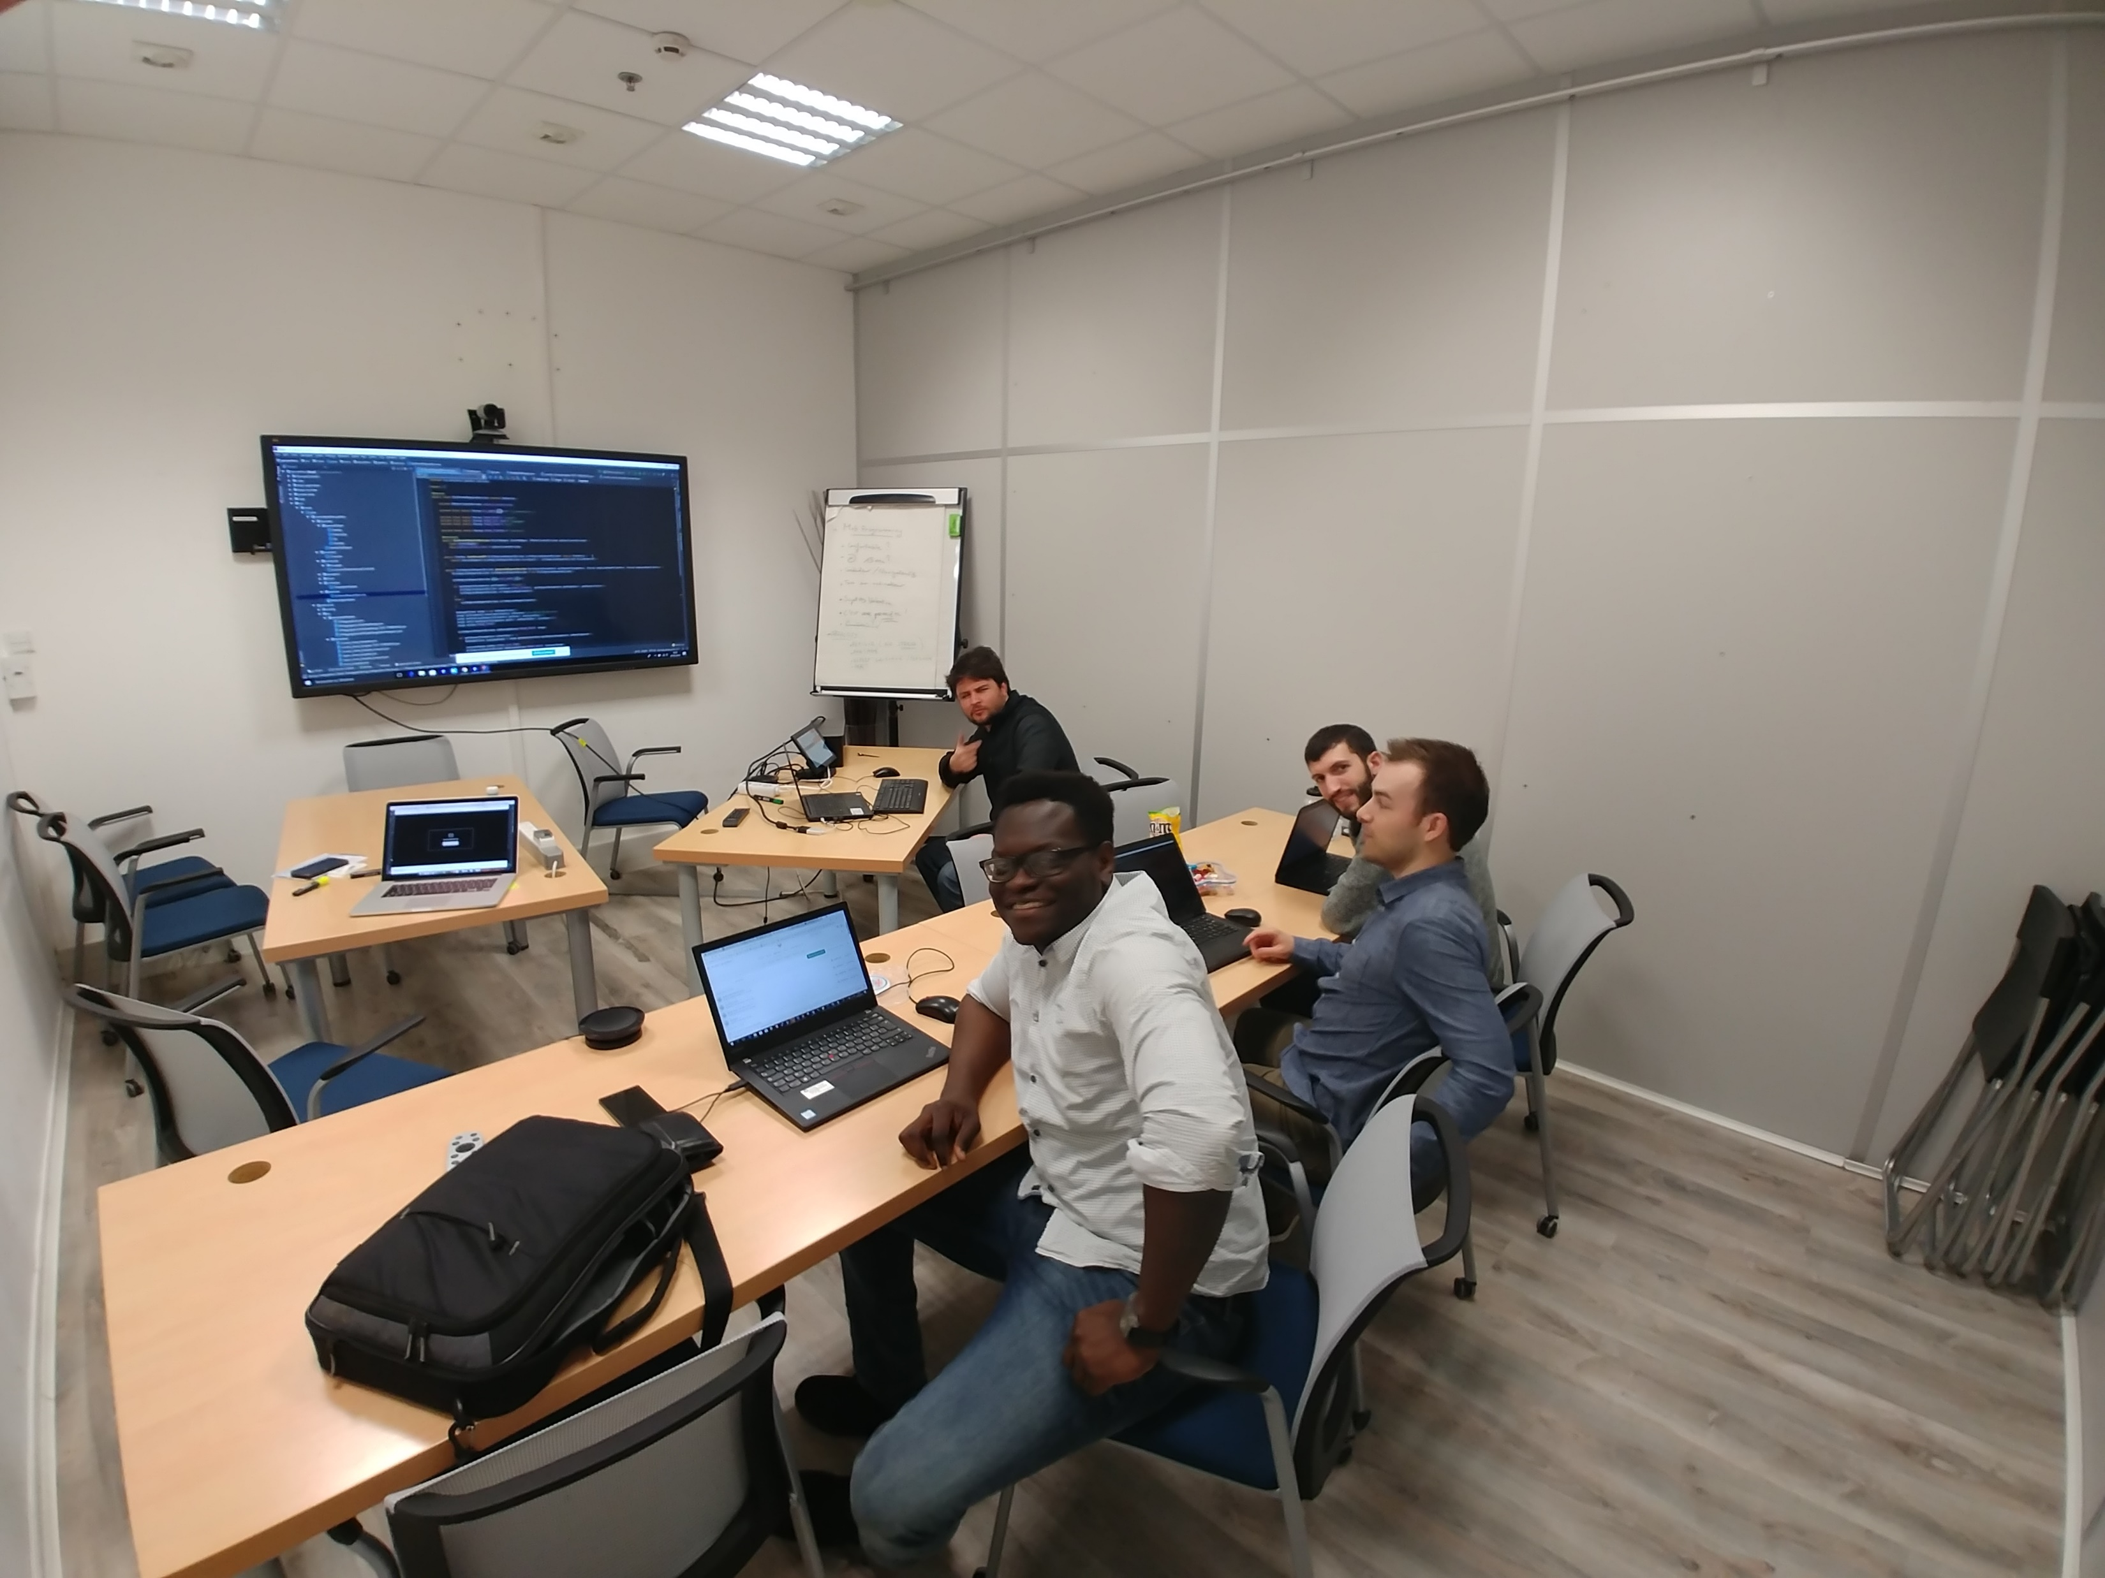
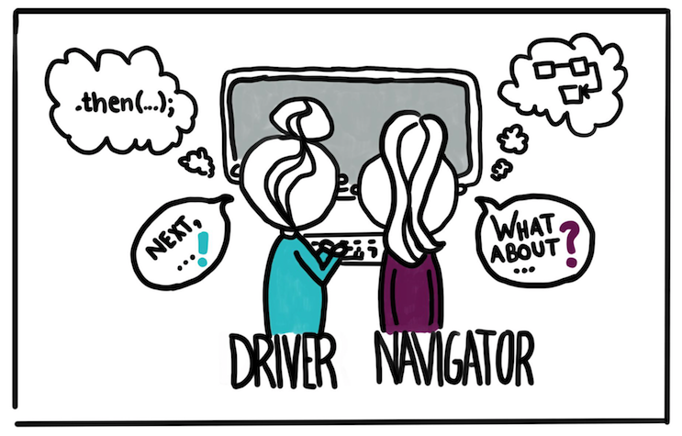
Programming Together
Pair Programming & Mob Programming

Slide 14
AUTOHACK IDLE
an incremental game for lazy coders

Slide 15
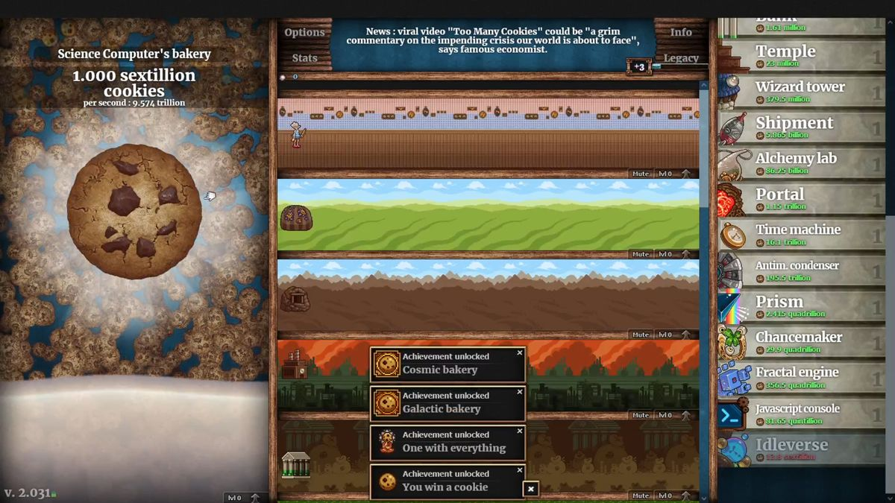
Project Introduction
What’s an incremental game?
Or…
candybox2.github.io

Slide 16
AUTOHACK IDLE
A game like that, but where you learn to code along the way
This game will help the Hyland Tech Outreach team reach new audiences in a new and engaging way
The idea is to gamify computer science education

Slide 17
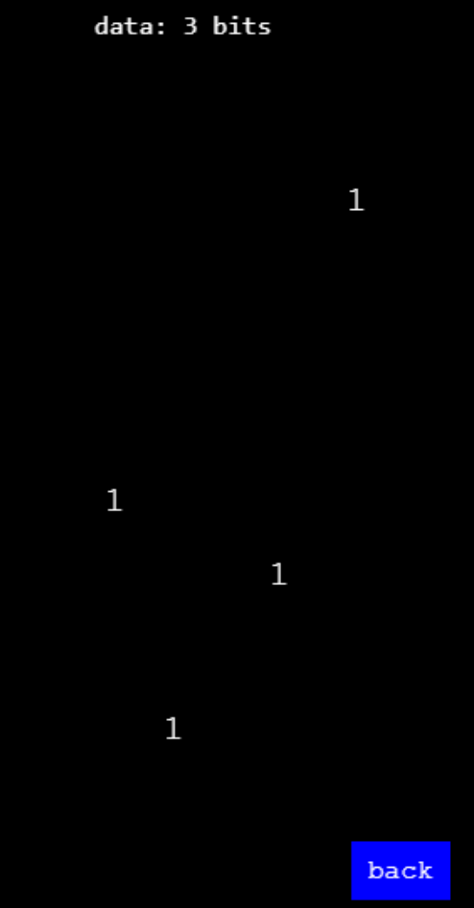
Gameplay
The player tries to collect bits
Whac-A-Mole style
Players can sell data
Players can buy upgrades
The game can be “hacked”
Through learning!

Slide 18
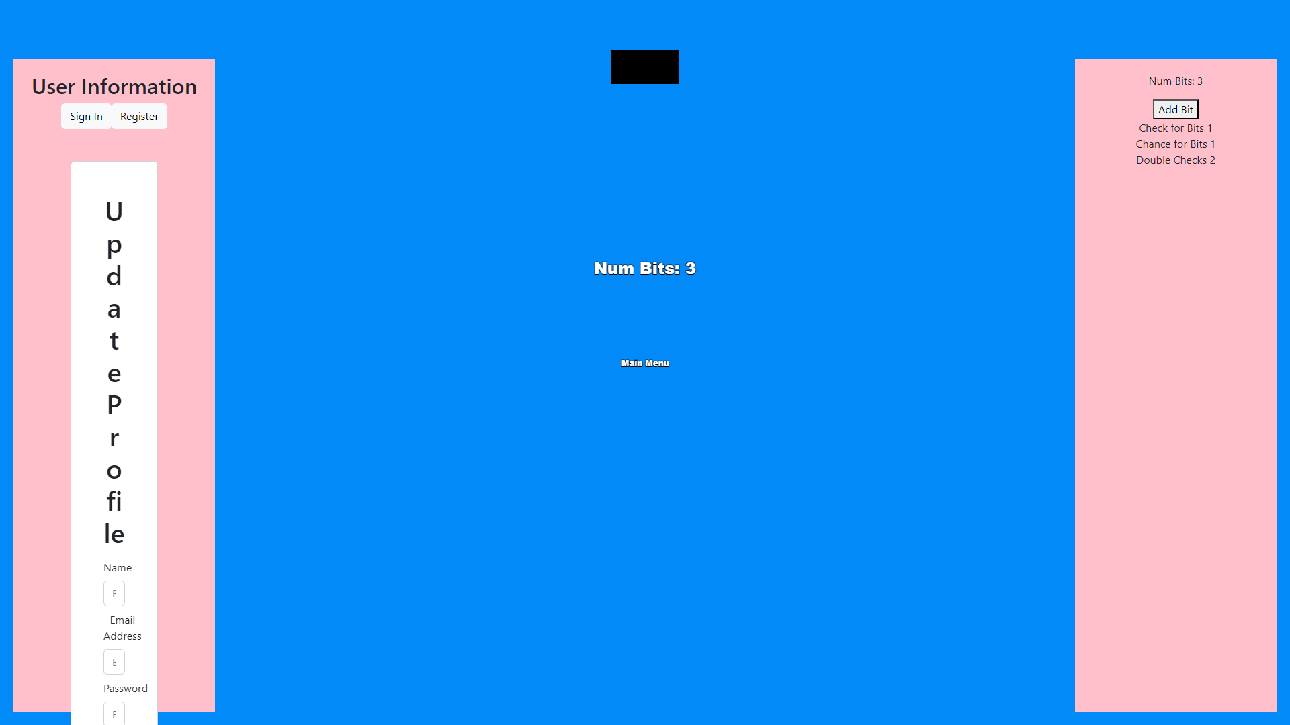
Current State
Doesn’t look great
Lots of room for improvement!

Slide 19
Development Plan
“start-here” Issues
Basic Upgrade Functionality (frontend)
U.I. Beautification
CS Learning Journeys

Slide 20
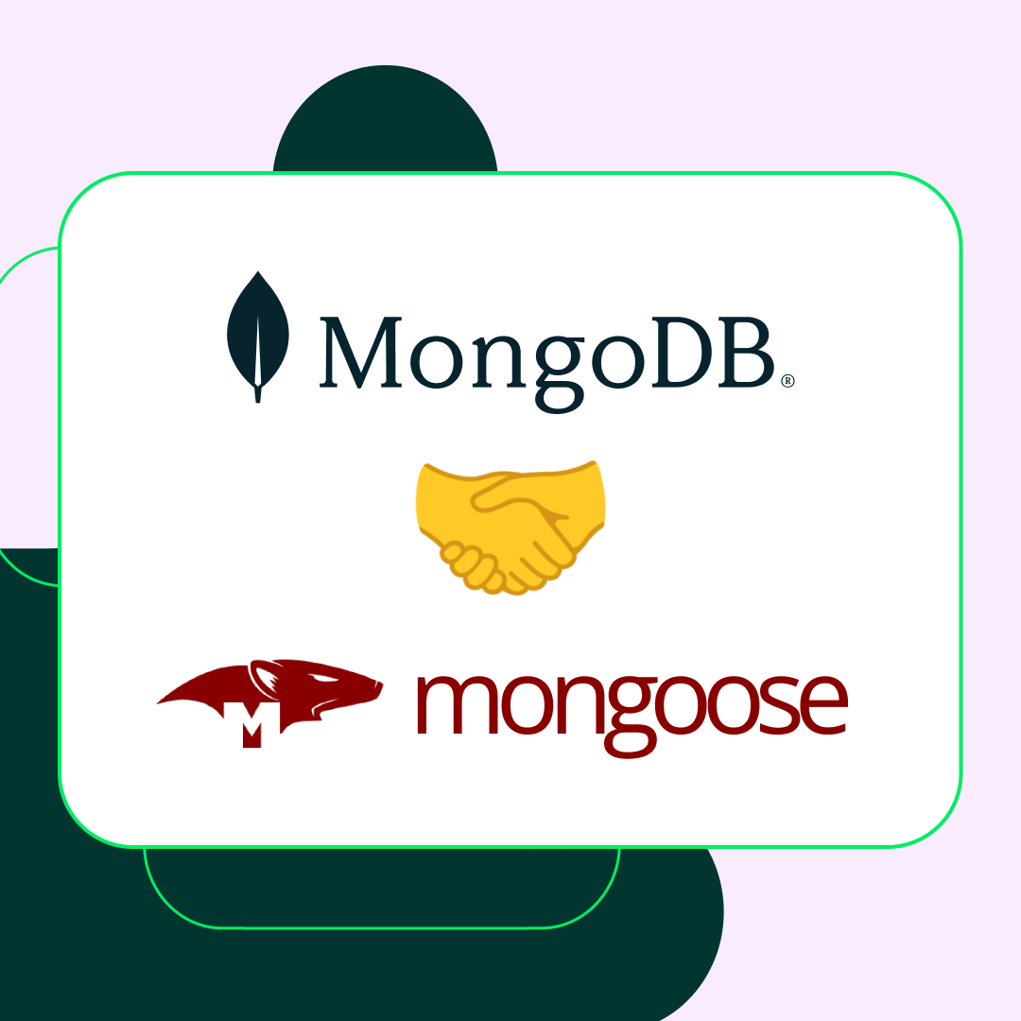

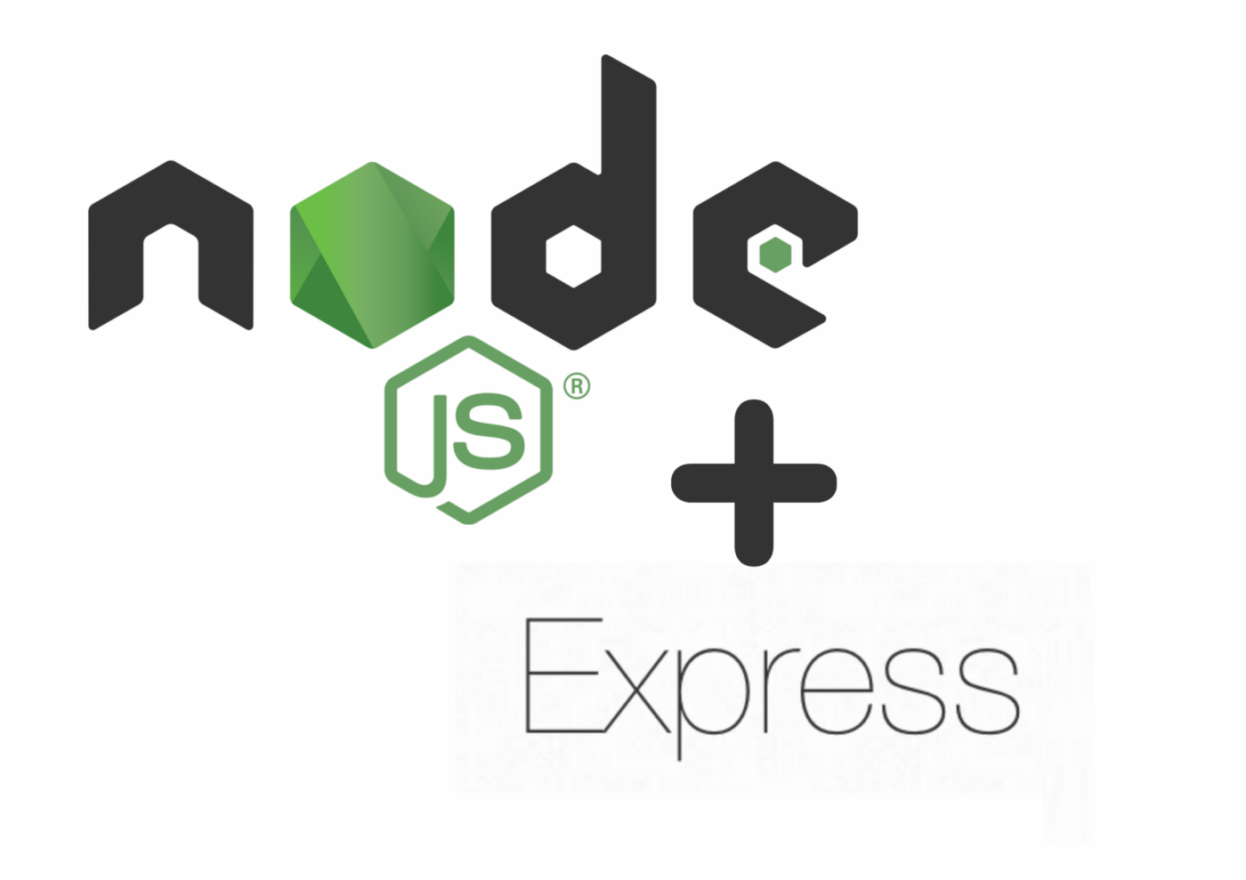
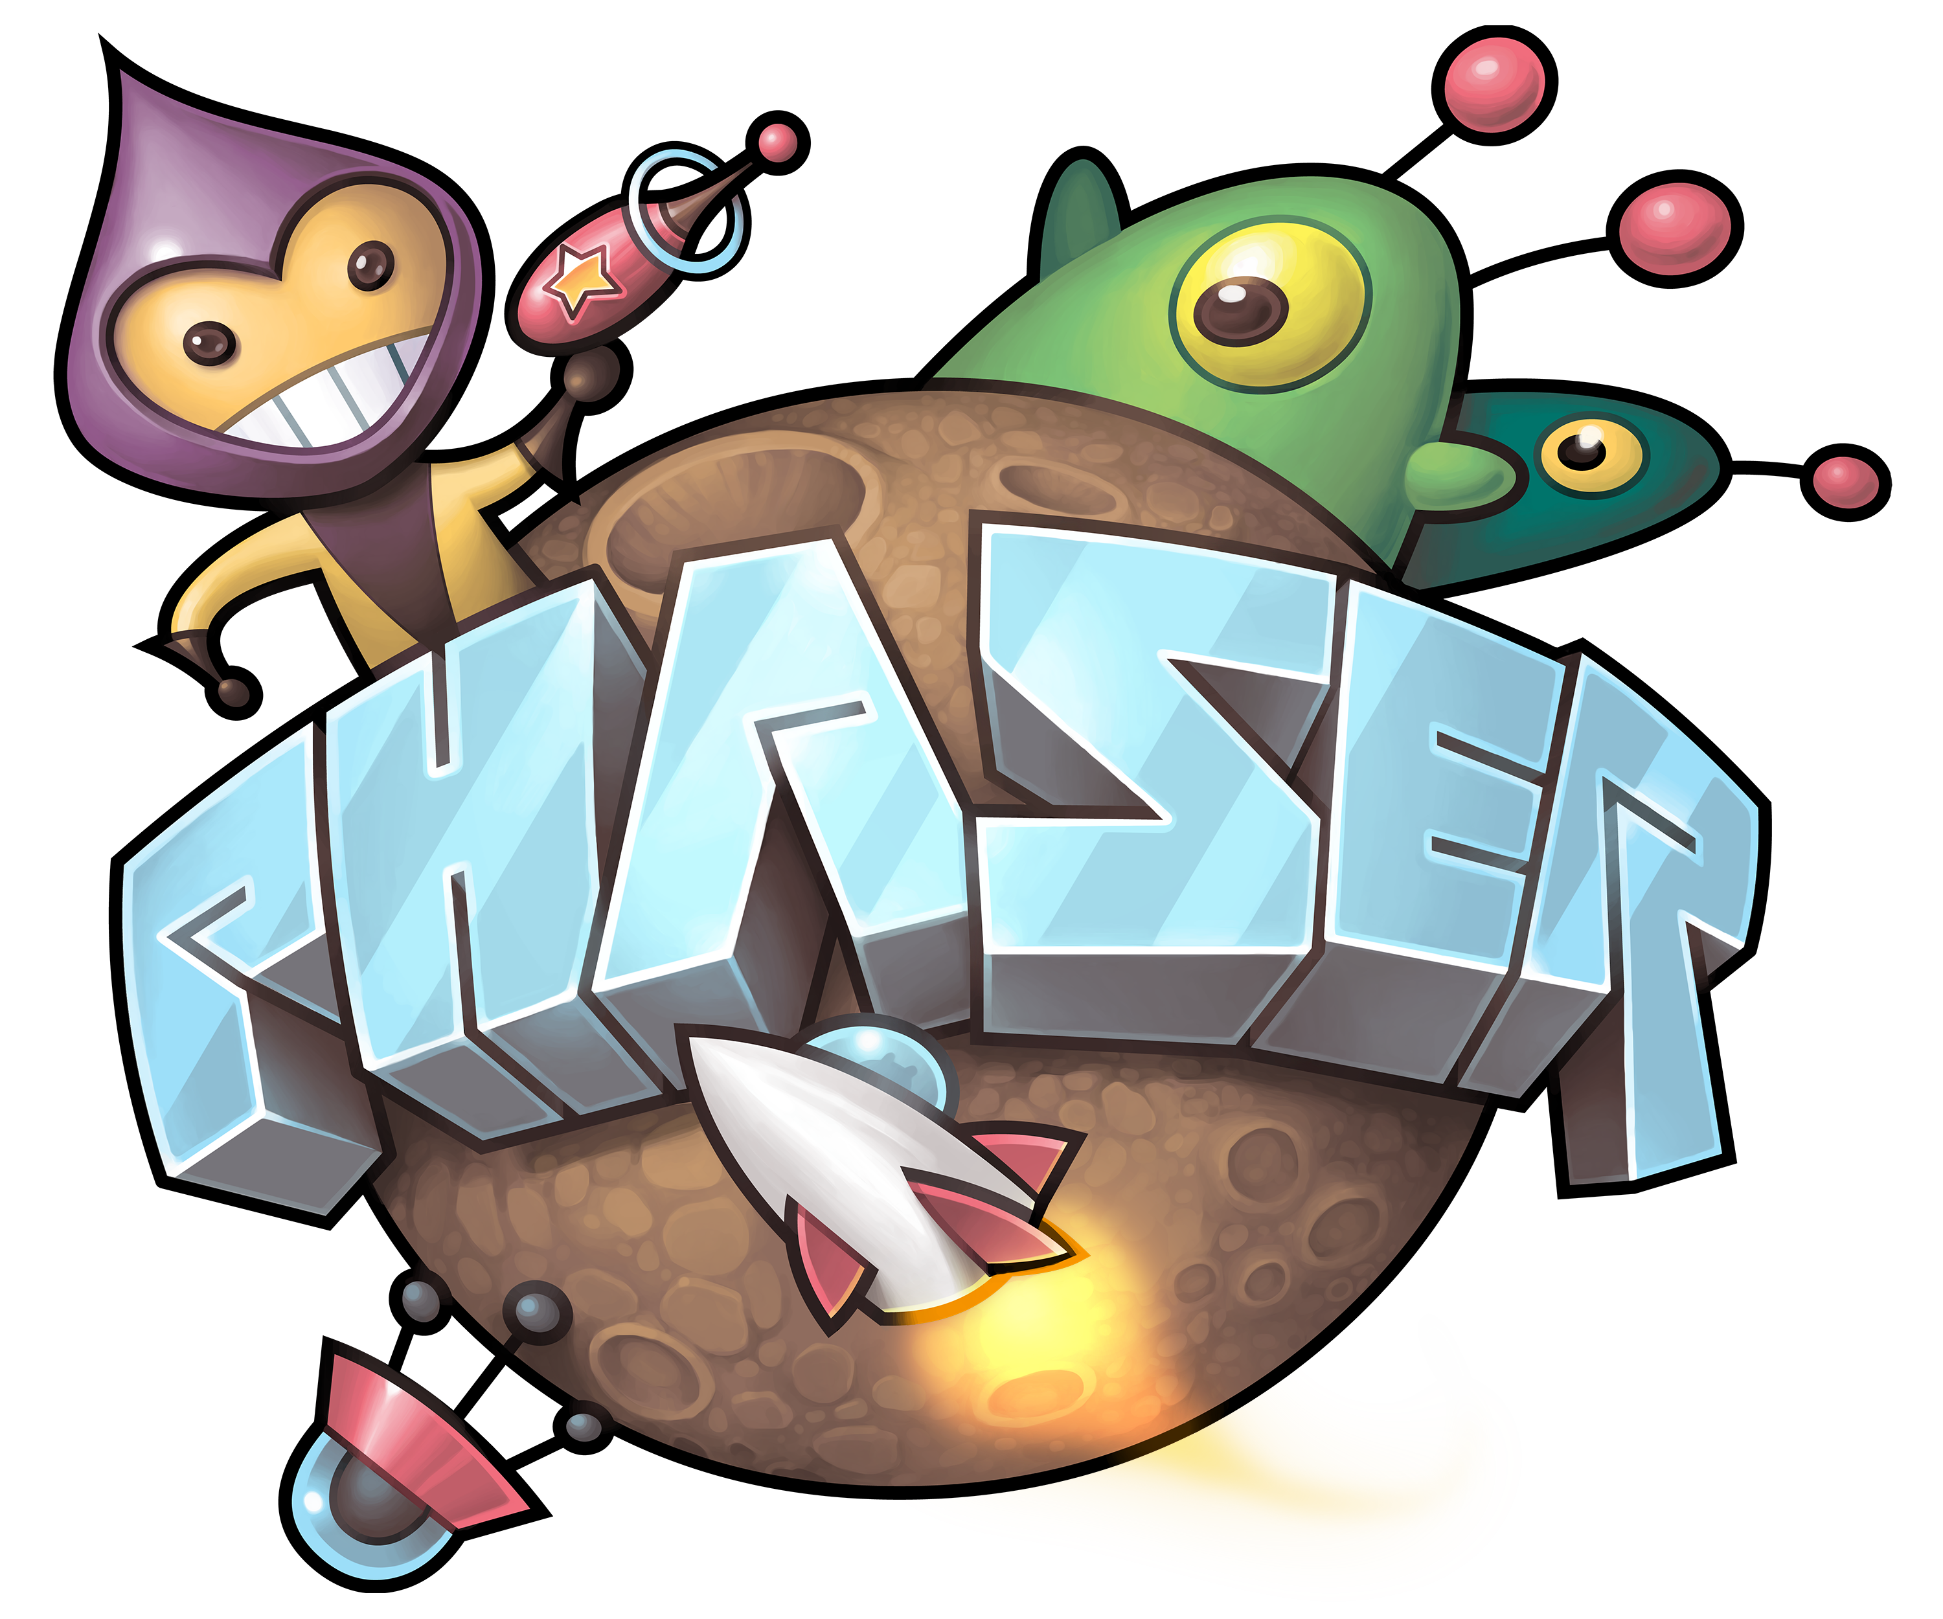

Technologies
Shared
TypeScript
Backend
Node.js, Express, MongoDB, Mongoose
Frontend
React, Redux, Vite, Phaser

Slide 21
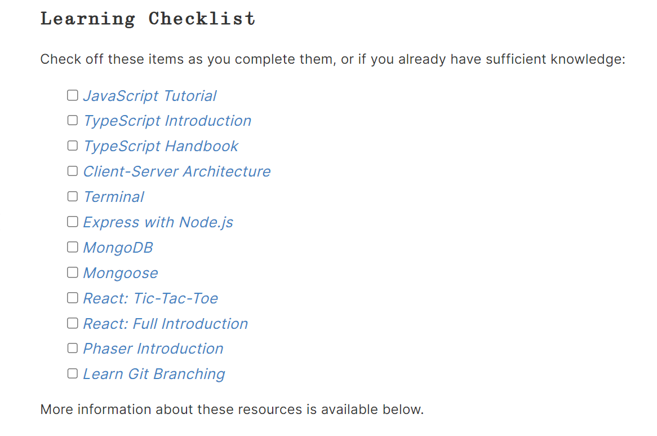
Learning Paths
Available on the internship site

Slide 22
Project Quickstart
Contribute to the codebase right away by completing one of the “start-here” issues.
We’ll go over an example of the entire workflow.

Slide 23
First Week Checklist
gotta check ‘em all!

Slide 24
First Week Goals
Environment setup
“start-here” issues
Team building
👍😀👍

Slide 25
THANK YOU
you are free to go

